Slide 1

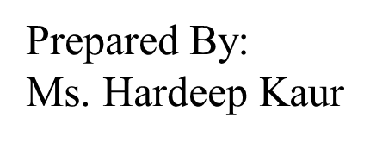
UNIVERSITY INSTITUTE OF ENGINEERING
COMPUTER SCIENCE ENGINEERING
Bachelor of Engineering (Computer Science & Engineering)
Subject Name: STATISTICAL METHODS USING R
Subject Code: 20SMT-460

Slide 2
Median
Definition: The median is a measure of central tendency that represents the middle value of a dataset when it is ordered from least to greatest. It is not affected by extreme values, making it a robust measure for skewed distributions.

Slide 3
Calculation: To find the median:
For Odd Number of Observations:
Arrange the data in ascending order.
The median is the middle value.
Example: Consider the dataset: 3, 1, 7, 5, 9 Arranged in ascending order: 1, 3, 5, 7, 9 Median = 5

Slide 4
For Even Number of Observations:
Arrange the data in ascending order.
The median is the average of the two middle values.
Example: Dataset: 2, 8, 4, 6 Arranged in ascending order: 2, 4, 6, 8 Median = (4 + 6) / 2 = 5

Slide 5
Properties:
The median is unaffected by extreme values (outliers).
It is a suitable measure for skewed distributions.
In a perfectly symmetrical distribution, the mean and median are the same.

Slide 6
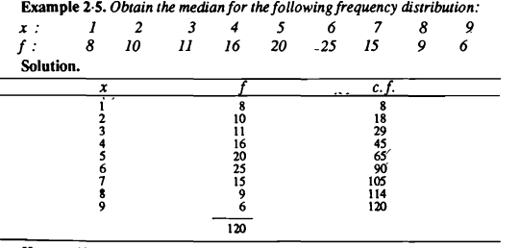


Slide 7
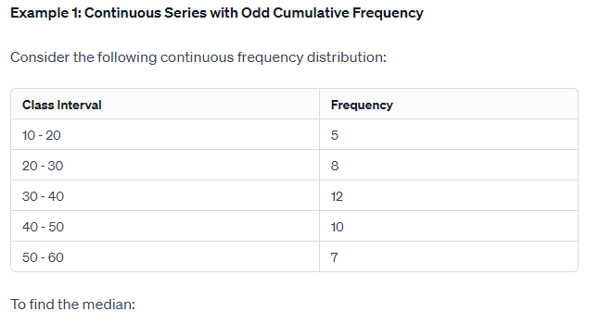

Slide 8
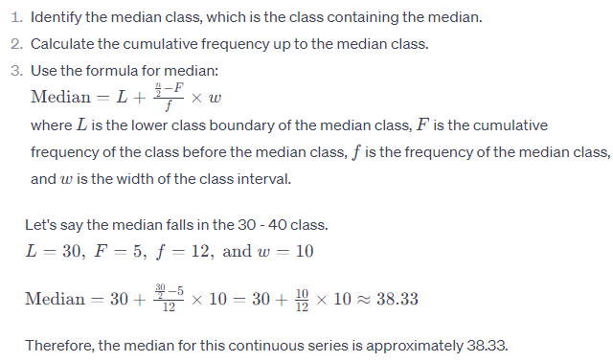

Slide 9
https://www.youtube.com/watch?v=kVopC1a2-ok&pp=ygUvbWVhc3VyZSBvZiBjZW50cmFsIHRlbmRlbmN5IGFuZCBkaXNwZXJzaW9uIGlpdCA%3D

